Slide 1

6. NetBeans
CBSE – Mundtlig Eksamen
pahan19@student.sdu.dk
Patrick Hansen

Slide 2
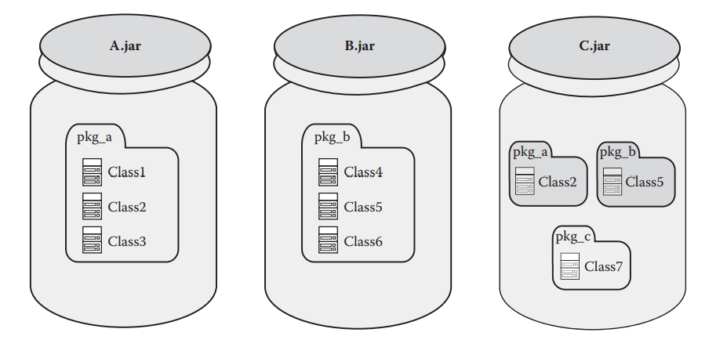
Hvorfor NetBeans?
Problemet med JAR fil-baseret komponent model
Flad classpath (præcedens!)
Komponent grænser ”opløses” ved runtime
Adfærd ændrer sig, runtime miljø bestemmer
Notes:
Root cause: The component boundary that keeps all related classes of the components together at development time is dissolving and dynamically changing at runtime

Slide 3
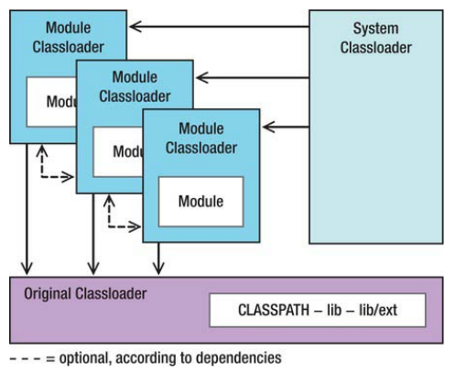
Hvordan løser NetBeans problemet?
Notes:
There are three types of classloaders in the Netbeans Classloader System:
Module Classloader
Each module registered in the module system has an instance of the module classloader, by means of which every module obtains its own namespace.
This classloader primarily loads classes from the module's JAR archive, but it may load from multiple archives, as often happens with library wrapper modules...
The original classloader is the parent classloader of every module classloader.
This multiparent module classloader enables classes to be loaded from other modules, while avoiding namespace conflicts. The loading of classes is delegated to the parent classloader, rather than the modules themselves.
System Classloader
By default it is a multiparent classloader. It owns all the instantiated module classloader as its parent.
Lets us load everything provided by a module with this class loader
It can be accessed in two different ways:
Lookup
ClassLoader cl = (ClassLoader) Lookup.getDefault().lookup(ClassLoader.class);
Context classloader of the current thread
ClassLoader cl = Thread.currentThread().getContextClassLoader();
Original Classloader
The original (application) classloader is created by the launcher of the application.
Loads classes and other resources on the original CLASSPATH and from the lib directories and their ext subdirectories
If a JAR archive is not recognized as a module (that is, the manifest entries are invalid), it is not transferred to the module system.
Such resources are always found first
If those found here are also found in a module JAR, the ones in the module are ignored.

Slide 4
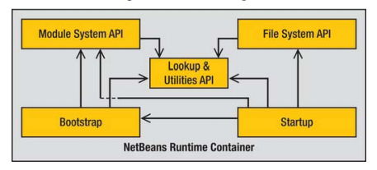
Runtime Container & Module resolution
Notes:
The basis of the NetBeans Platform and its modular architecture is called NetBeans Runtime Container
It consists of the following five modules:
Bootstrap: Executed initially
Executes all registered command-line handlers
Creates a boot classloader, which loads the startup module, and then executes it
Also responsible to start the platform-specific launcher (for Windows, a .exe), which identifies the Java Runtime Environm
Startup: Deploys the application by initializing
the module system
the file system
Module System API: Responsible for management of the modules and their settings and dependencies
File System API: Provides a virtual file system which provides a plat-form independent access
Is mostly used for loading resources of the modules
Lookup & Utilties API: Provides an important base component which is used for the intercommunication of the modules
Can be used independently of the NetBeans Platform
Structure of a Module
A module is a simple JAR file which usually consists of the following parts
Manifest file (manifest.mf)
Identifies a module.
Layer file (layer.xml)
Class files
Resources
Module Resolution
Starting the runtime container, it finds all available modules and creates an internal registry out of them.
Usually, modules are just loaded when needed, at first they are just registered as "Existing"
A module can do tasks at startup, by using the Module Installer (Chapter 3). The runtime container also facilitates dynamic loading, unloading, installing, and uninstalling of modules during runtime.
Necessary for users when updating an application (with the auto update function).
Also necessary for deactivating unneeded modules within an application

Slide 5
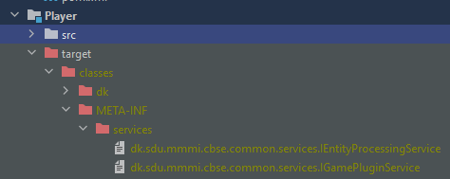
Registrering af en Service med Annotations
@ServiceProviders(value = {
@ServiceProvider(service = IEntityProcessingService.class),})
public class PlayerControlSystem implements IEntityProcessingService { … }

Slide 6
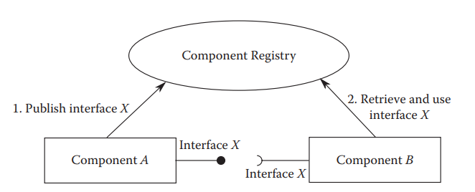
Whiteboard modellen

Slide 7
Tilgåelse af services med Lookup API
Lookup lookup = Lookup.getDefault();
private Lookup.Result<IGamePluginService> result;
result = lookup.lookupResult(IGamePluginService.class); result.addLookupListener(lookupListener);
result.allItems();
for (IGamePluginService plugin : result.allInstances()) {
plugin.start(gameData, world);
gamePlugins.add(plugin);
}

